Slide 1
Capstone Project 1

Slide 2
Data Engineer Bootcamp
Presented by: Amjad, Ghadah, Sadeem, Amal

Slide 3
Agenda Style
01
Project Requirements
02
Project Process
03
Demos
Future Plans
04

Slide 4
Project Requirements
AWS
Lambda Function
We created instances for Docker and Metabase
Loading tables and setting up event bridge
W 07
W 07
W 08
W 08
Airbyte
Snowflake
Metabase
Loading tables from source to destination (Snowflake)
ETL - Data Modeling – Testing - DML – DDL -Scheduling
Data Visualization

Slide 5
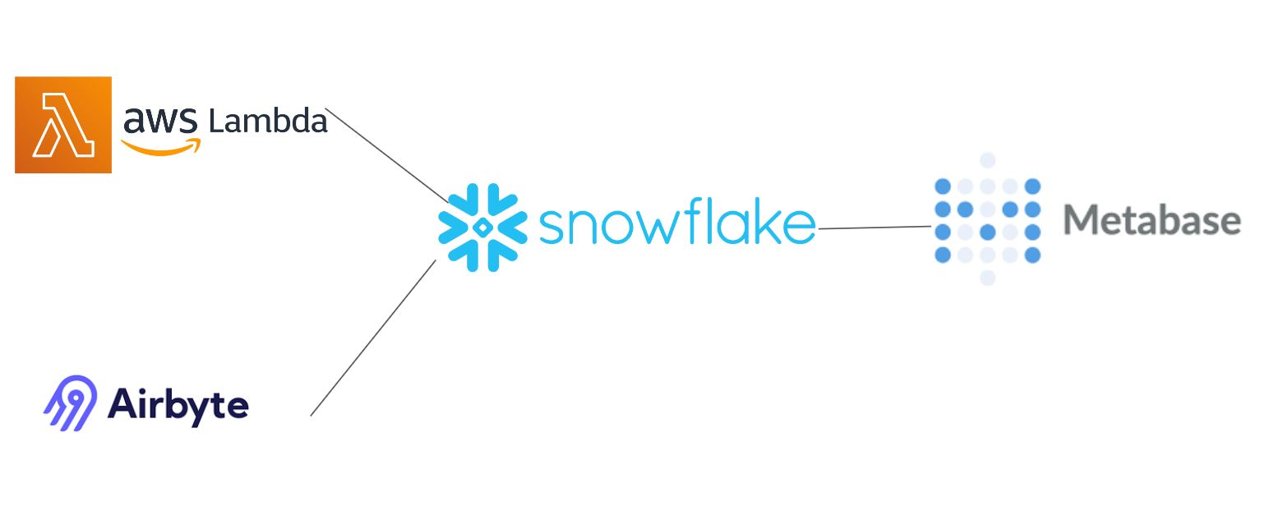
project process

Slide 6
Lambda Demo

Slide 7
Airbyte Demo

Slide 8
Snowflake Demo

Slide 9
Metabase Demo

Slide 10
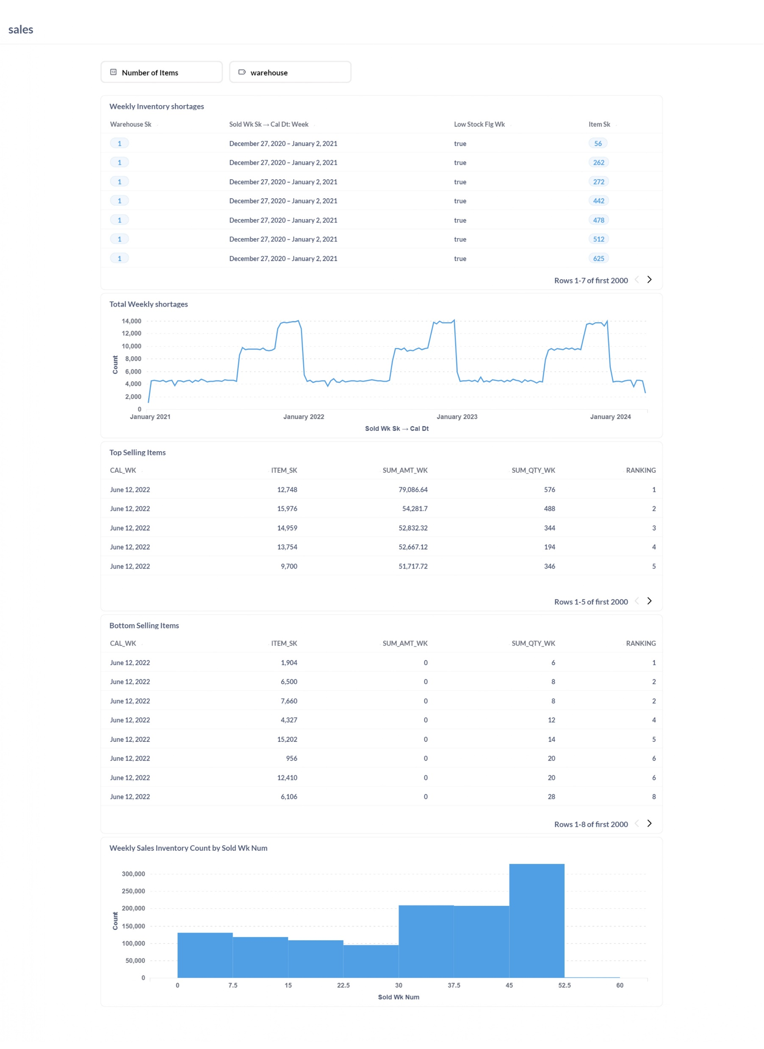

Slide 11
FutureFuture
Future
Improvements
We aim to add more business requirements and improve data quality, enhance visualization techniques, and streamline workflows
One Task
make lambda function update everyday at 2p.m
Further Research
We'd like to explore advanced tools like Power BI, and machine learning algorithms to uncover deeper insights from the data and investigate emerging trends in the industry.

Slide 12
Thank you!

